Slide 1

DreamCorps
Let Children Lead The Future
Presented by World Peach Tech
Yimei Tong, Zi Chai, Huaqiu Zheng, Hengyi Hu

Slide 2
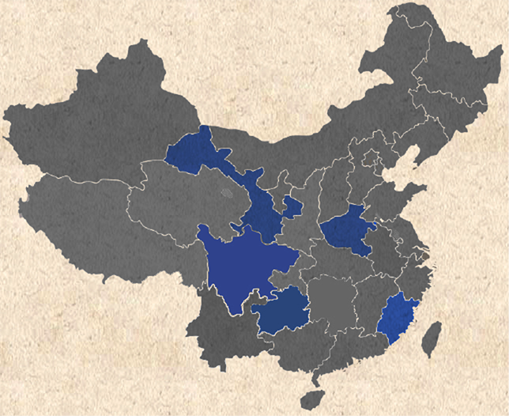
10 Worldwide Universities
17 Libraries
$15,000 Raised
41,000 Books
Notes:
DreamCorps Background

Slide 3

Chapter
Event
Program
Department
Donor
Volunteer
Executor
Donation
Library
Money Donation
Book Donation
Notes:
Entities

Slide 4
Entity Relationship Diagram

Slide 5
Program
Date
Time
Volunteer
Program_ID
Program_Name
Start_Date
End_Date
Maximum#OfEnrollment
Volunteer_ID
Volunteer_FirstName
Volunteer_LastName
Phone
Email
Address
Date_Joined
Executors
Executer_ID
Executer_FirstName
Executer_LastName
Phone
Email
Date_Joined
Role
Department
Event
Donation
Department_ID
Department_Name
Job_Description
Event_ID
Event_Name
Date
Description
Date
Date_Established
Chapter
O
Chapter_ID
Chapter_Name
Address
Donor
Donor_ID
Donor_FirstName
Donor_LastName
Phone
Email
Address
MoneyDonation
BookDonation
AmontOfMoney
Book_ID
Book_Name
Library
Library_ID
Library_Name
Address
Date_Established
Notes:
ERD

Slide 6
Executors
Executer_ID
Executer_FirstName
Executer_LastName
Phone
Email
Date_Joined
Role
Department
Department_ID
Department_Name
Job_Description
Executive Structure
Date_Established
Chapter
Chapter_ID
Chapter_Name
Address
Notes:
ERD1 (Executor, Department, Chapter)

Slide 7
Event
Donation
Donation
Events
Event_ID
Event_Name
Date
Description
Date
O
Donor
Donor_ID
Donor_FirstName
Donor_LastName
Phone
Email
Address
MoneyDonation
BookDonation
AmontOfMoney
Book_ID
Book_Name
Notes:
ERD2 (Event, Donor, Donation, BookDonation, Money Donation)

Slide 8
Program
Date
Volunteer
Program_ID
Program_Name
Start_Date
End_Date
Maximum#OfEnrollment
Volunteer_ID
Volunteer_FirstName
Volunteer_LastName
Phone
Email
Address
Date_Joined
Library
Programs
BookDonated
Book_ID
Book_Name
Library
Library_ID
Library_Name
Address
Date_Established
Notes:
ERD3

Slide 9
Logical Design
Using Visio

Slide 10
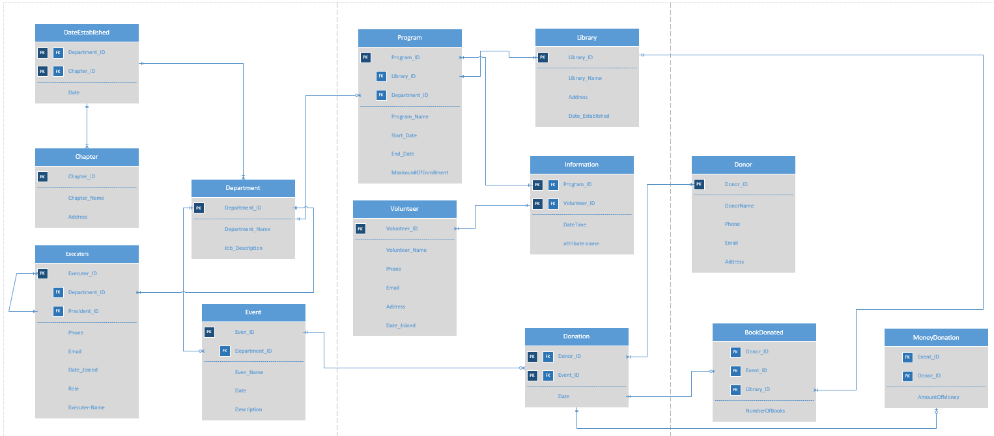
Logical Design Using Visio

Slide 11
User Interface
Using Oracle
Notes:
User Interface

Slide 12
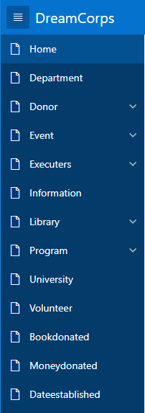
Bloomington Donors
Finance Executors
Qinghua Library
Big Programs
Volunteer Form
Notes:
Navigation Bar Explanation

Slide 13
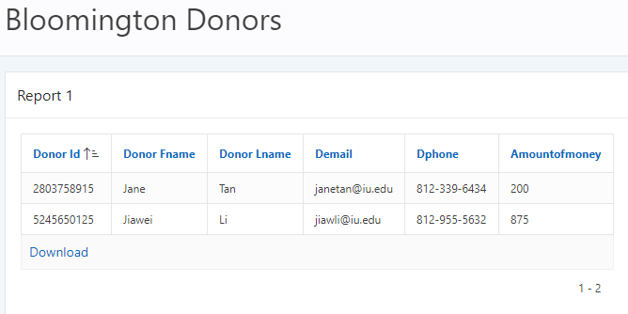
Select d.Donor_ID, Donor_FName, Donor_LName, DEmail, DPhone, AmountOfMoney
From Donor d, MoneyDonated m
Where DPhone like '812%' AND d.Donor_ID = m.Donor_ID AND AmountOfMoney >= 100;
Notes:
Bloomington Donors

Slide 14
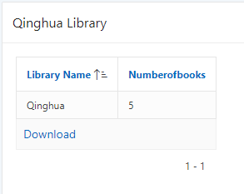
Select Library_Name, NumberOfBooks
From Library l, BookDonated b
Where l.Library_ID = b.Library_ID
AND l.Library_Name = 'Qinghua';
Notes:
Bloomington Donors

Slide 15
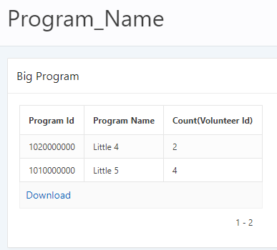
Select i.Program_ID, Program_Name, Count(Volunteer_ID)
From Information i, Program p
Where i.Program_ID = p.Program_ID
Group by i.Program_ID, Program_Name
Having count(Volunteer_ID) >= 2
Order by Program_Name;

Slide 16
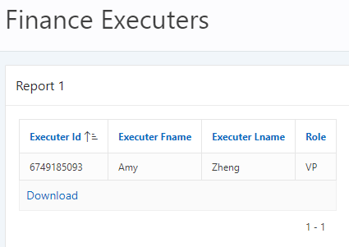
Select Executer_ID, Executer_FName, Executer_LName, Role
From Executers
Where Department_ID in
(select Department_ID
from Department
where Department_name = 'Finance');

Slide 17
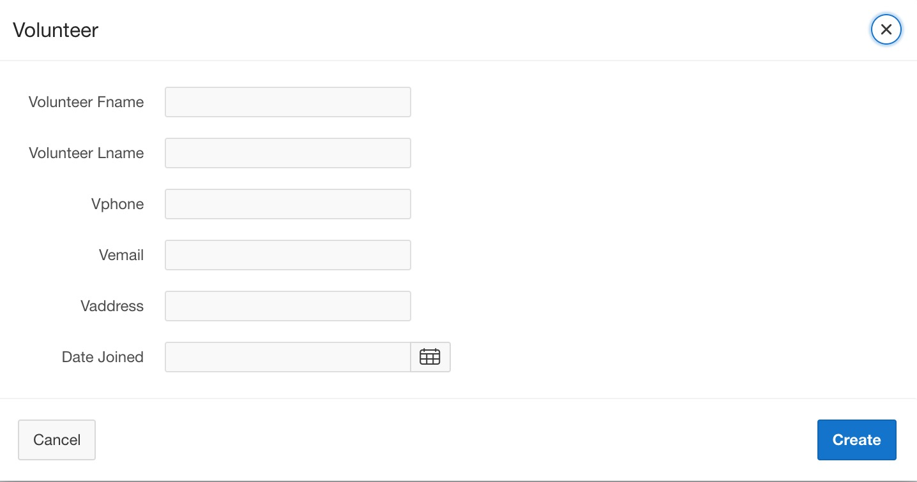

Slide 18


Slide 19
Q & A

